Slide 1
VMC Hackathon 2024
VMC.Chatbot – KB
ZHAO Dong
JENDRYSIK Nadine
BERINGHOFF Jens
Jun 7th, 2024
Notes:
Today we are going to demonstrate the results achieved so far from our VMC.Chatbot team and something we’ve learned along the way.

Slide 2
Available Input Data – Simufact Forming
Documentation
Infosheets (.odp)
Tutorials
Introduction (.pptx)
Basics, Application, Scientific (.xml)
Python Documentation (.html)
Short descriptions
Code
Python unit tests, example scripts and examples in the documentation
Other
Installation Guide (.xml)
Salesforce Articles
Customer Group Trainings pptx-slides
xml
html
static website
Input:
Output:
Data preparation required replacement of external entities via Python

Slide 3
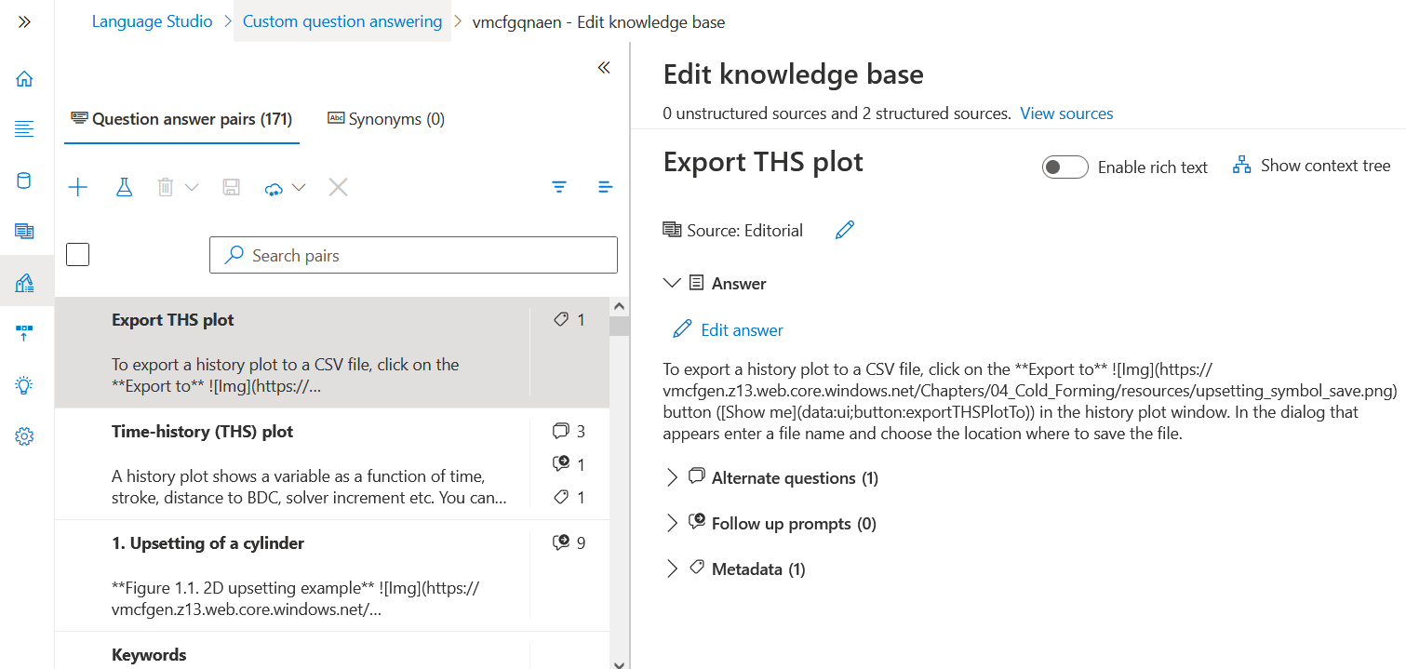
Approach 1: Language Studio (Q&A)
Upload Documentation (URL)
Review automatically created Question and Answer pairs
Configure answers manually (add/remove follow up prompts & metadata)
Can easily embed images or links in answers
Questions and answers need to be very specific with no overlap to get desired answers
Does not seem to work very well with just using our current documents
No actual training of the data
Answers are not generated but taken as is

Slide 4
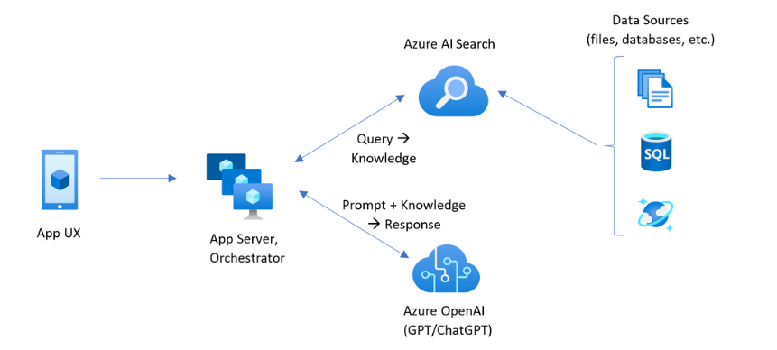
Approach 2: Open AI – Use existing Language Model
https://learn.microsoft.com/en-us/azure/search/retrieval-augmented-generation-overview, 06.06.2024

Slide 5
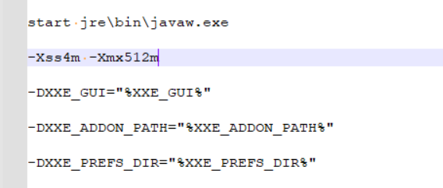
Troubleshooting Data
XML MIND | xml to html | xml to html (single file)
xml tutorial | does not work with external entities | does not work with external entities
xml tutorial replaced entities | cannot be uploaded directly in Language Studio! | images are external files
Pandoc | xml to md | html to md
xml tutorial | does not work with external entities
xml tutorial replaced entities | does not work with xi::includes
html output (single file) from xml mind |  | images are missing, md is empty
Pandoc HTML -> MD
C:\dev\SimufactDoc\Notes\thirdPartySoftwareNotice\bin\pandoc\pandoc.exe -o Basics_en.md -f html -t markdown Basics_en.html --verbose
XMLmind XML -> HTML
1. Replace external entities via Python
2. Docbook -> Convert files
Freezing XML mind? (https://www.xmlmind.com/xmleditor/faq.html#outofmemory )
C:\Program Files (x86)\XMLmind_XML_Editor\bin\xxe.jstart

Slide 6
What’s learned?
What’s the advantages of using chatbot instead of searching documents?
Searching documents: context unaware / multiple results without ranking
Using chatbot: context aware / responses based on confidence level
What are the advantages of our Embedded VMC.Copilot (EC) vs. Microsoft Copilot (MC)?
Knowledge domains:
MC: public domain
EC: selected public + private domains
Answer format:
MC: most are text based without images
EC: anything we want
Interaction within software:
MC: not feasible
EC: anything we want
Can I use it in other products?
Yes, the core is NuGet packaged and can be easily adapted to any product

Slide 7
What’s learned? (Cont.)
Why choose Microsoft Azure, not AWS, Google AI or other service providers?
We have subscriptions with Microsoft Azure
Is it safe to let Azure AI Service digest my documents and scripts?
Yes, those are user materials in public domain
Is it expensive to use the Azure Blob Storage service?
No
Is it expensive to use the Azure Language Cognitive Service?
Depends on the service call volume, in my experiment: $0/m(F0) or ~$40/m (S1) for 18M document training and querying. The tier is controllable.
Projecting in production ~$100/m for one product
Comparing tons of subscription credits are wasted, this is just a tiny fraction of the expenses.
Is it expensive to use the Azure OpenAI Service?
Affordable (https://azure.microsoft.com/en-ca/pricing/details/cognitive-services/openai-service/)

Slide 8
What’s learned? – Knowledge Database
What’s the best way to upload and store my knowledge documents?
Azure Blob Storage Service (Static Web Hosting due to less strict file and storage limit)
What’s the best document format for feeding the engine?
Language Studio: Structured Text + Resource Links: MARKDOWN, HTML
OpenAI: .md, .<any code>, .txt, .html, .docx, .pptx, .pdf
Does it take very long time to digest the documents?
No, the performance is good
How can I improve my Knowledge Database?
Language Studio: Add Synonyms and follow-up prompts or manually adjust answers/questions
OpenAI: The more/better the input, the better the answers
Can I test my Knowledge Database and improve the answers?
Yes, test tools are available

Slide 9
What’s learned? – Interaction
Can I call Azure Language Cognitive Service or Azure OpenAI directly from my Qt application?
Yes, using Qt Network module
How are the given answers generated?
Language Studio: answers are not generated but taken as provided, can easily include images or links
OpenAI: answers are generated based on the knowledge database
Can the engine learn from my script examples and generate script for me?
Language Studio: No, it’s not meant for code understanding and generation
OpenAI: Yes, it can understand script examples and learns from it to generate script
Can it translate something, or can I ask using a different language and get answers in that language?
Language Studio: should work in combination with Azure Language Translation service
OpenAI: Yes, just tell it to translate something, answer/ask in a specific language works as well.

